Slide 1


K.RAMAKRISHNAN COLLEGE OF TECHNOLOGY
(AUTONOMOUS), TRICHY
HELPDESK MANAGEMENT SYSTEM
PRESENTED BY SUPERVISOR
PREETHI B Mrs.K.Valli Priyadharshini M.E., (PhD),
2303811710422121 AP/CSE.

Slide 2
PRESENTATION OVERVIEW
Objective
Project Introduction
Problem Statement
Methodologies (Programming concepts relevant to problem statement)
Architecture of the proposed system
List of Modules
Merits
Results and Discussion
Queries

Slide 3
OBJECTIVE
The HelpDesk Management System aims to efficiently manage customer support requests, allowing customers to log and track issues, while helping companies resolve them quickly and in an organized way.
2/7/20

Slide 4
PROJECT INTRODUCTION
The HelpDesk Management System helps manage customer support requests. Customers can report issues, track their status, and get updates. Company staff can organize, prioritize, and resolve these issues quickly. This system improves communication, reduces delays, and ensures faster solutions, leading to better customer satisfaction.
2/7/20

Slide 5
PROBLEM STATEMENT
Implement a HelpDesk Management System for a Company to handle customer support requests, track ticket statuses, and improve response times.
2/7/20

Slide 6
METHODOLOGIES
Encapsulation: Groups related data and actions (like user info and tickets) into classes, keeping data safe.
Inheritance: Allows creating different user types (like Customer or Admin) based on a basic class.
Polymorphism: Changes how actions (like ticket handling) work depending on the user.
Abstraction: Simplifies user interactions by hiding complex details, like using buttons to "Create Ticket" or "View Tickets."
2/7/20

Slide 7
METHODOLOGIES
Swing and AWT: Used to build the user interface with components like buttons, labels, and layouts.
Event Handling: Manages user actions, such as logging in or creating tickets, using listeners
Error Handling: Prevents crashes by catching errors like invalid inputs during ticket resolution.
2/7/20

Slide 8



ARCHITECTURE OF THE PROPOSED SYSTEM
HELPDESK MANAGEMENT SYSTEM
LOGIN MODULE
Company Dashboard
Customer Dashboard
Create Support Ticket
View My Tickets
Logout
View All Tickets
Update Ticket Status
List All Customers
Logout
USER INTERFACE
CUSTOMER LOGIN
COMPANY LOGIN
2/7/20

Slide 9
LIST OF MODULES
Login Module
Customer Dashboard Module
Company Dashboard Module
Ticket Management Module
Logout Module
2/7/20

Slide 10
MERITS
Separate access for customers and companies.
Allows creating, viewing, and solving tickets instantly.
Allows customers to create and view tickets effortlessly.
Companies can view and resolve tickets efficiently.
Tracks tickets and their ownership systematically.
2/7/20

Slide 11
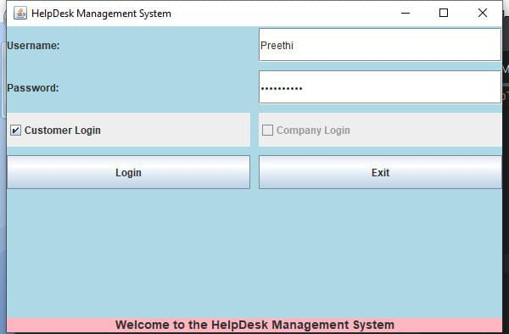
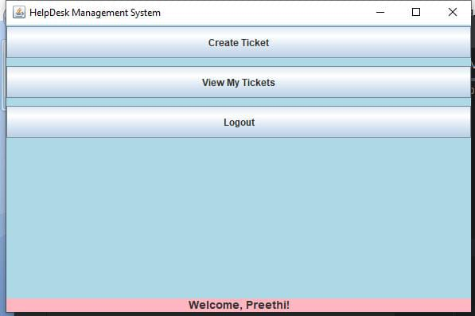
RESULTS AND DISCUSSION
Customer Login
Customer Dashboard
2/7/20

Slide 12
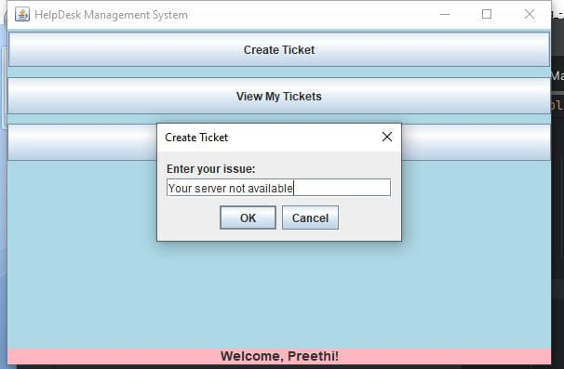
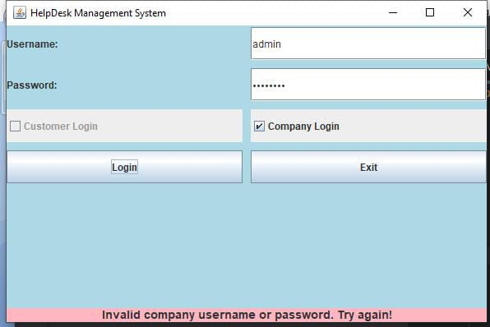
RESULTS AND DISCUSSION
Create Ticket
Company Login
2/7/20

Slide 13
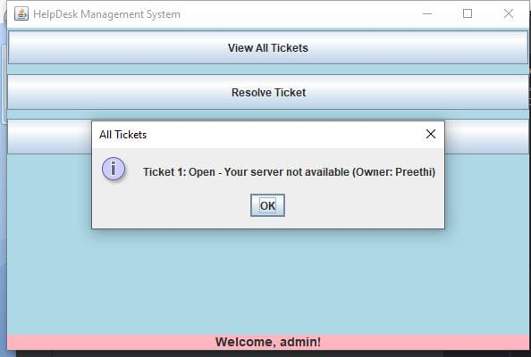
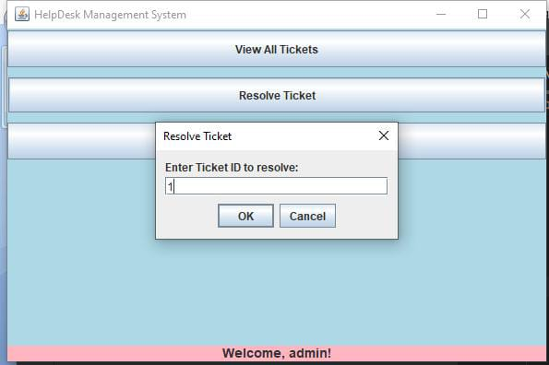
RESULTS AND DISCUSSION
View All Tickets
Resolve Ticket
2/7/20

Slide 14
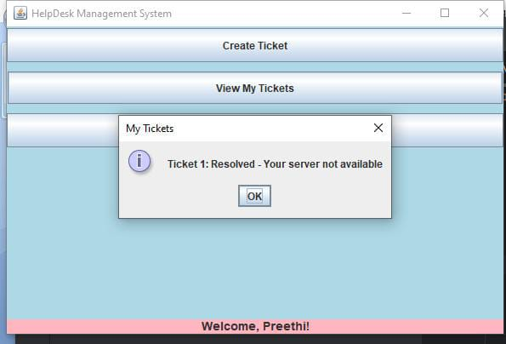
RESULTS AND DISCUSSION
Resolved message
2/7/20

Slide 15
Queries ?
2/7/20

